Slide 1
Management system for mobile store
This is a management system for a mobile store ,streaming inventory , sales and customer data handling

Slide 2
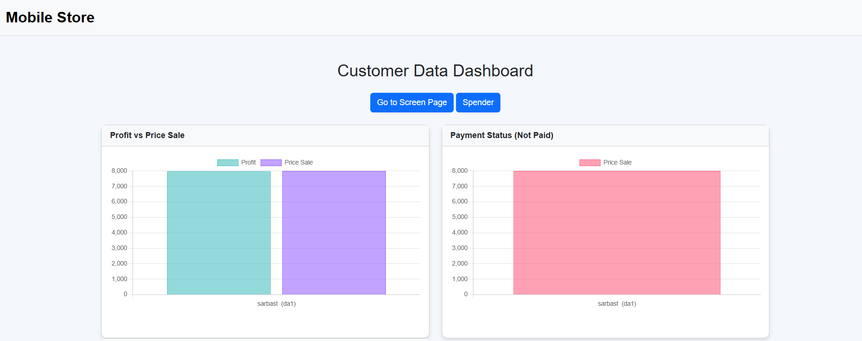
Home Page

Slide 3
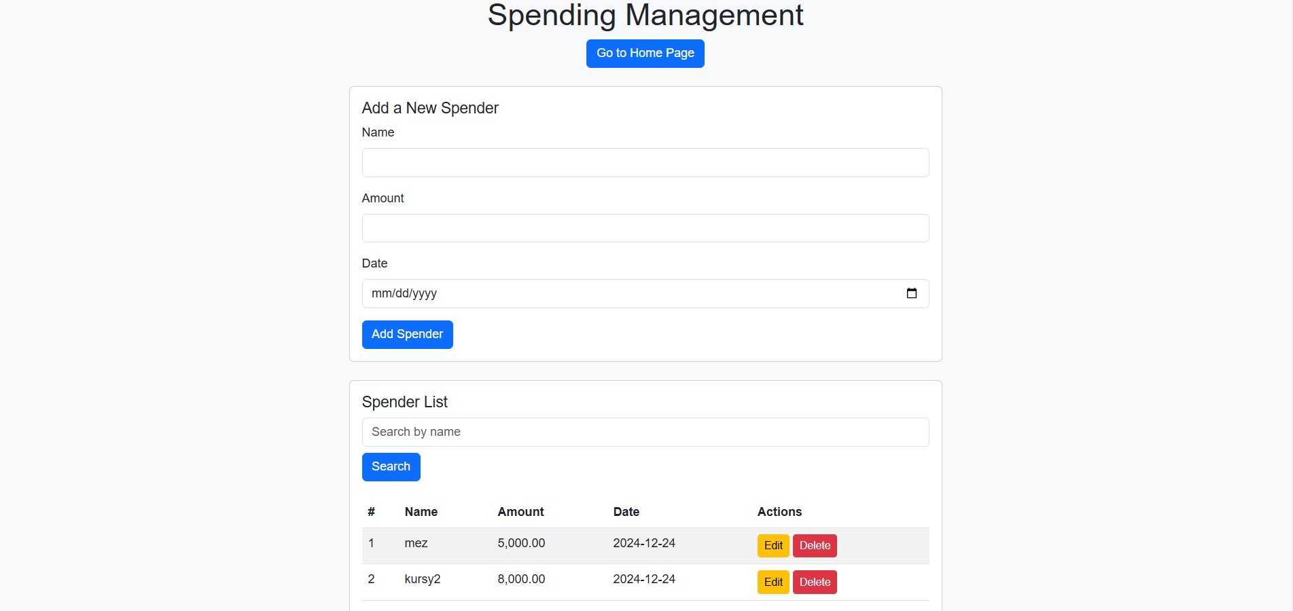
Spender for material store

Slide 4
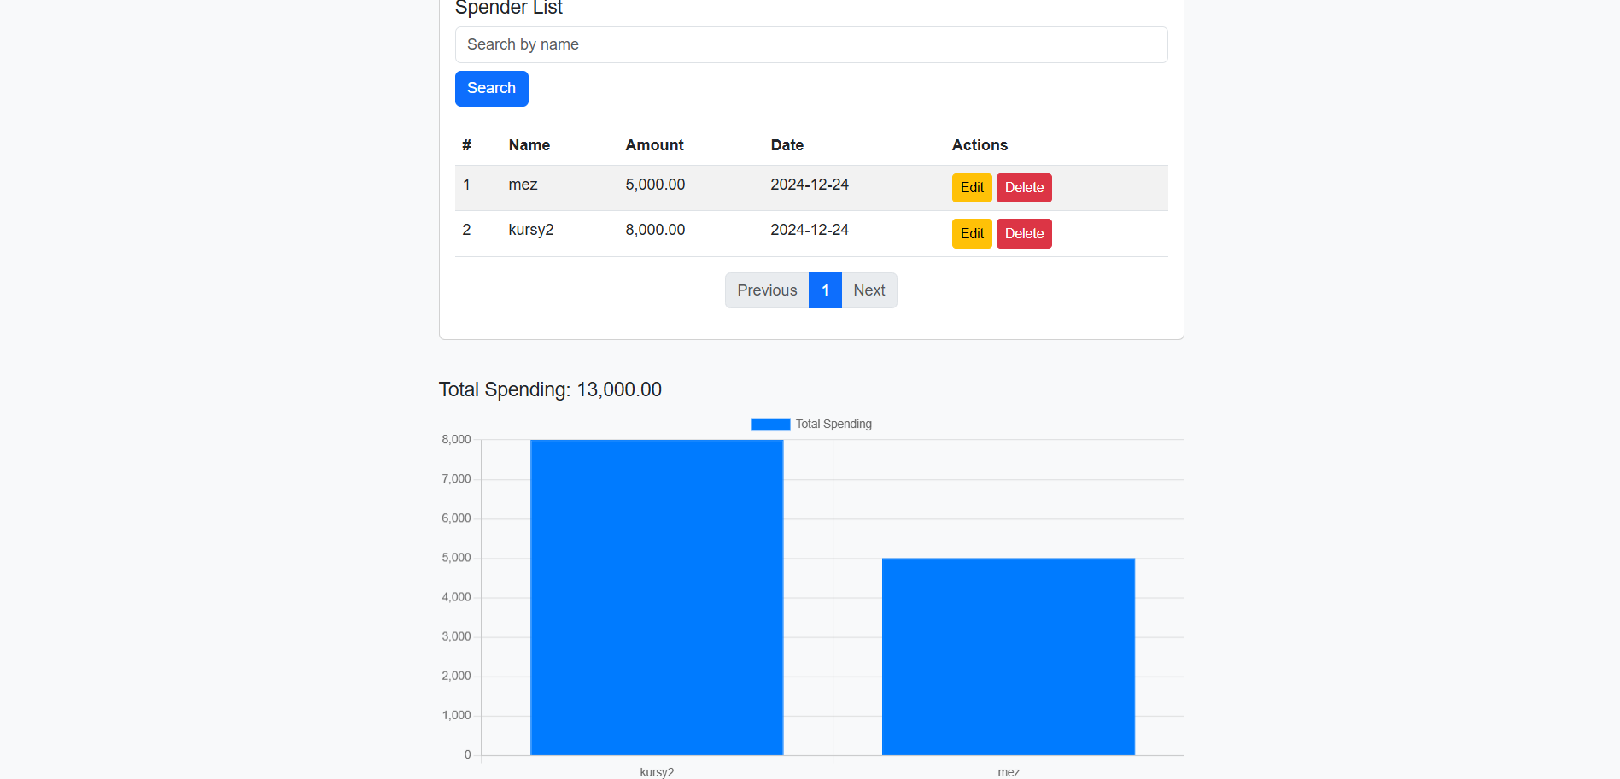
Spender for material store(con..)

Slide 5
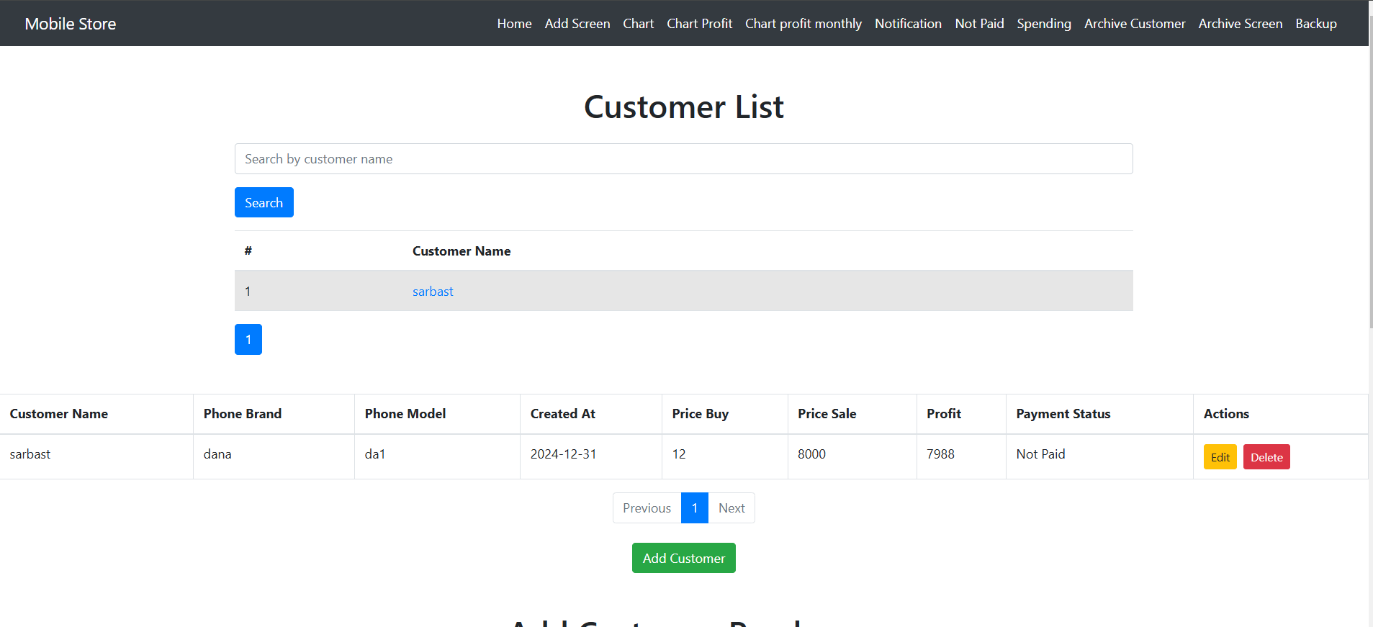
customer details

Slide 6
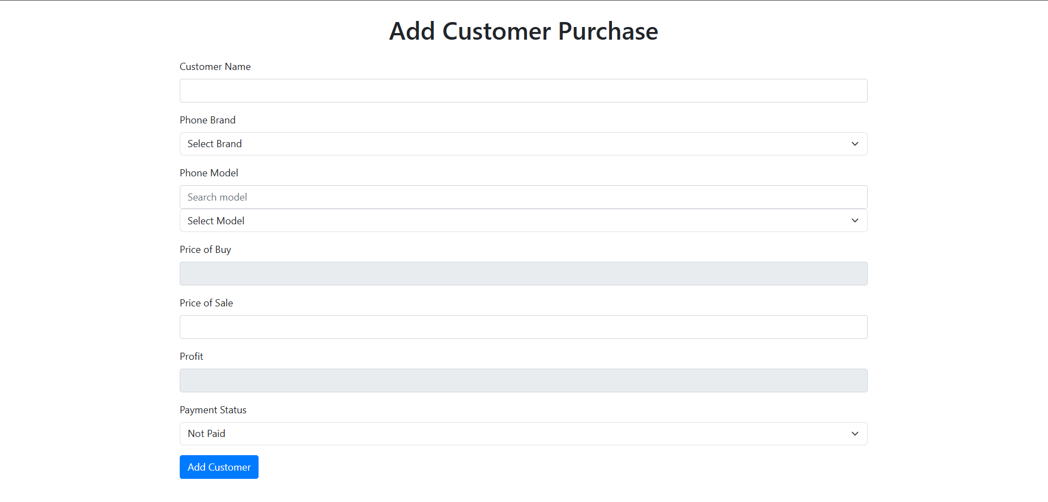
add new customer(con..)

Slide 7
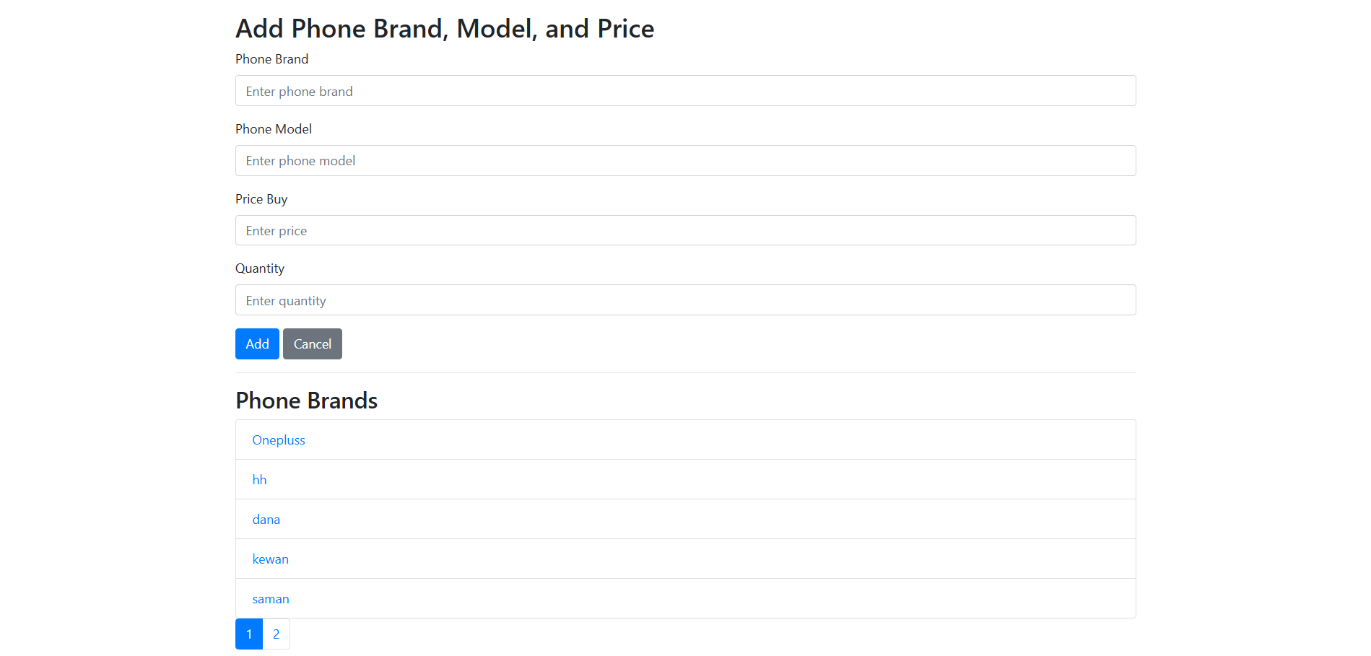
Add Screen

Slide 8
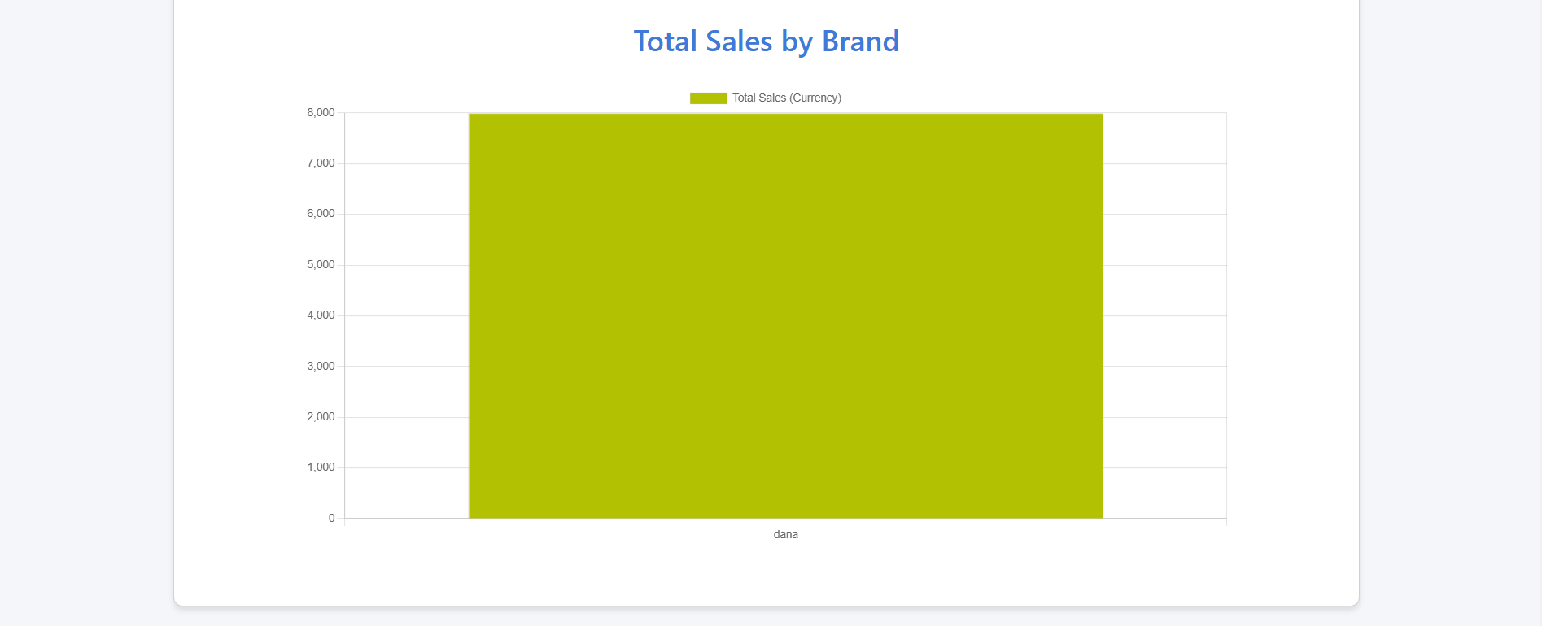
Total sales by chart

Slide 9
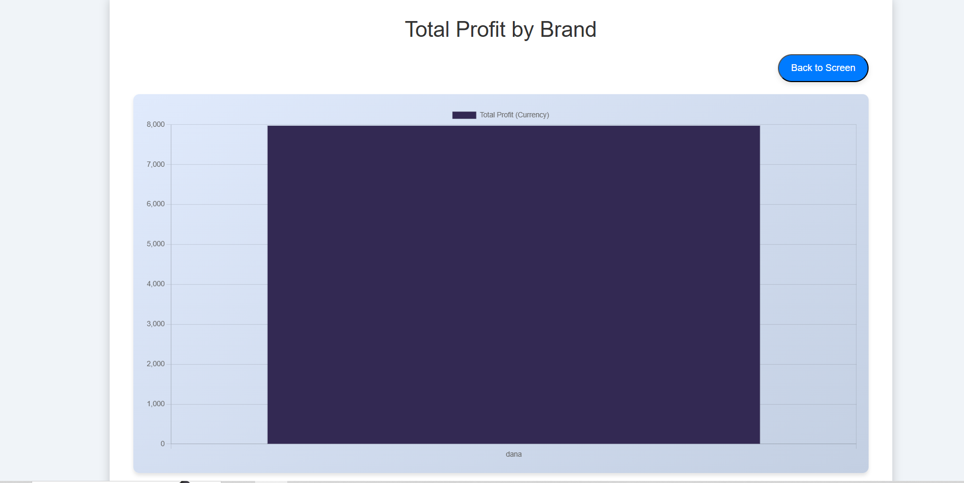
Total Profit by chart

Slide 10
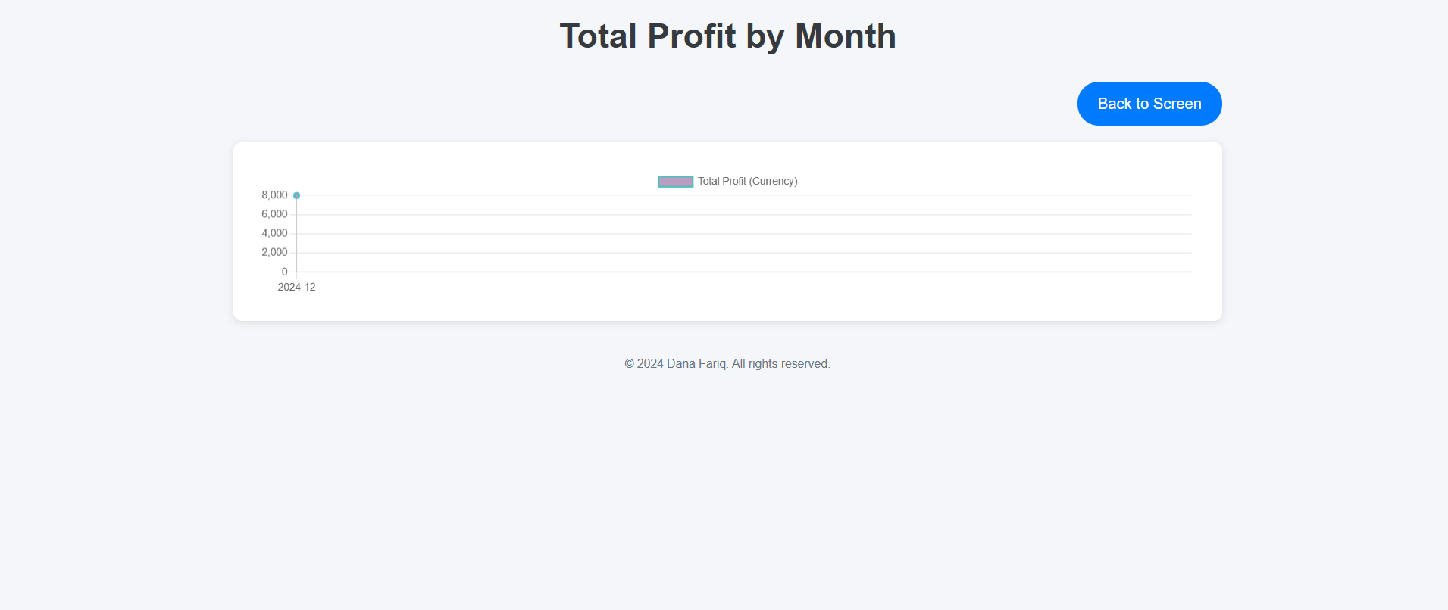
Total profit by month

Slide 11
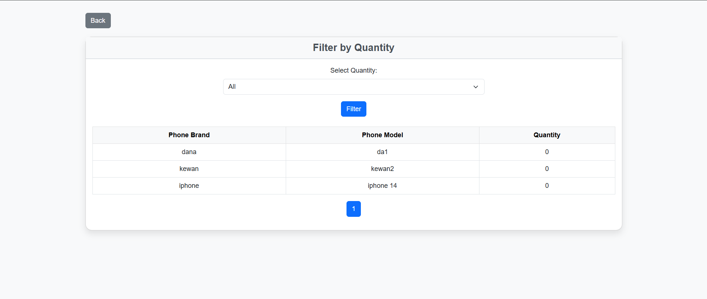
Notifications

Slide 12
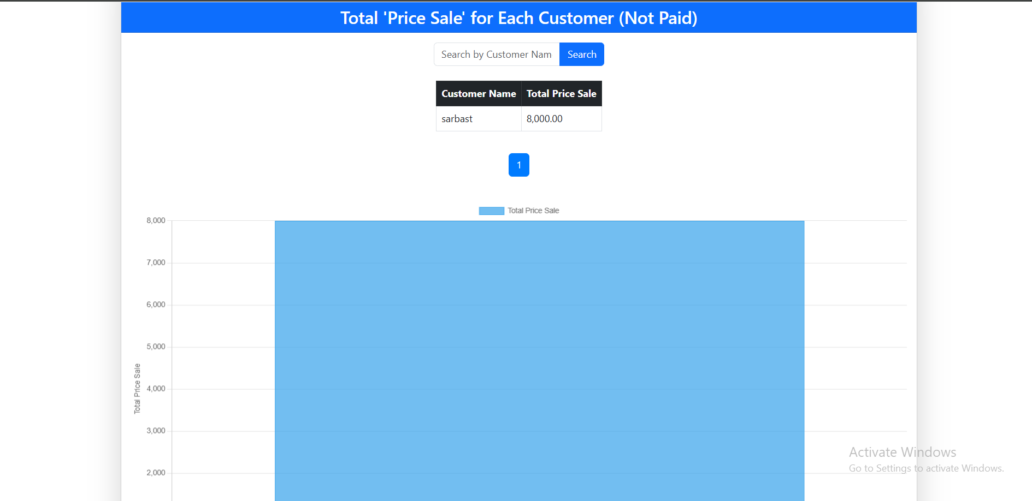
Not paid

Slide 13
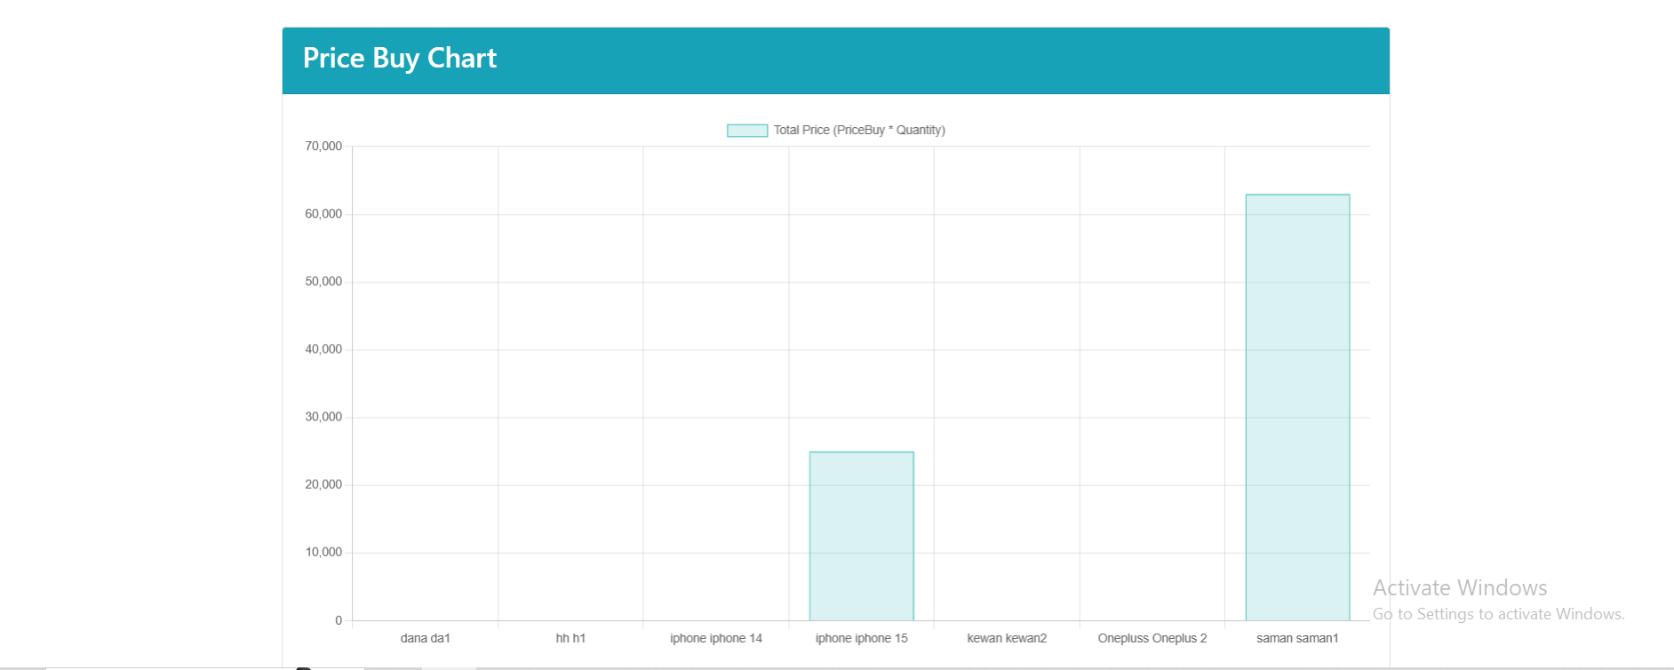
chart spending for screens

Slide 14
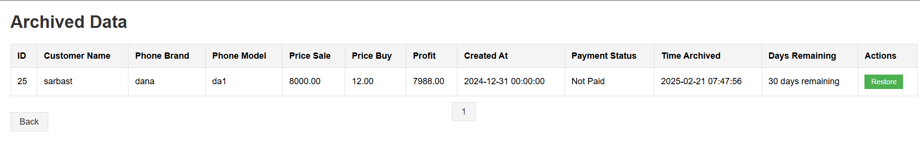
Archive for customer

Slide 15
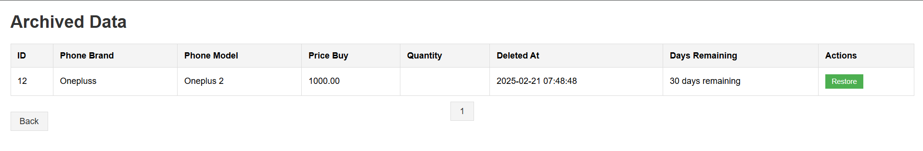
Archive for screens

Slide 16
Back Up button

